Slide 1
Linear and Logistic Regression Data Science Assignment 2
February 6, 2022
Daksh Patel

Slide 2
Linear Regression
Applying linear regression on the Boston Housing dataset with "MV" as the dependent variable.
Also get final dataset with reduced number of columns, utilizing p-value, correlation coefficient, and multiple R-squared statistics.
Libraries
pandas
numpy
matplotlib
statsmodels.api
sklearn

Slide 3
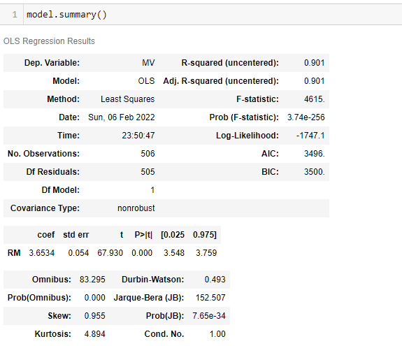
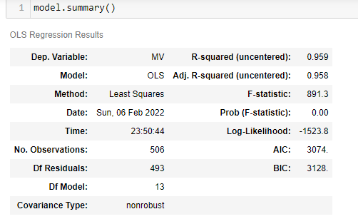
Output All Variables Vs Most Effective Variable

Slide 4
LogisticRegression
With “DECISION”as dependent variable.necessary one-hot encoding for the categorical variables and discard the irrelevant variables.
Libraries
pandas
numpy
sklearn

Slide 5
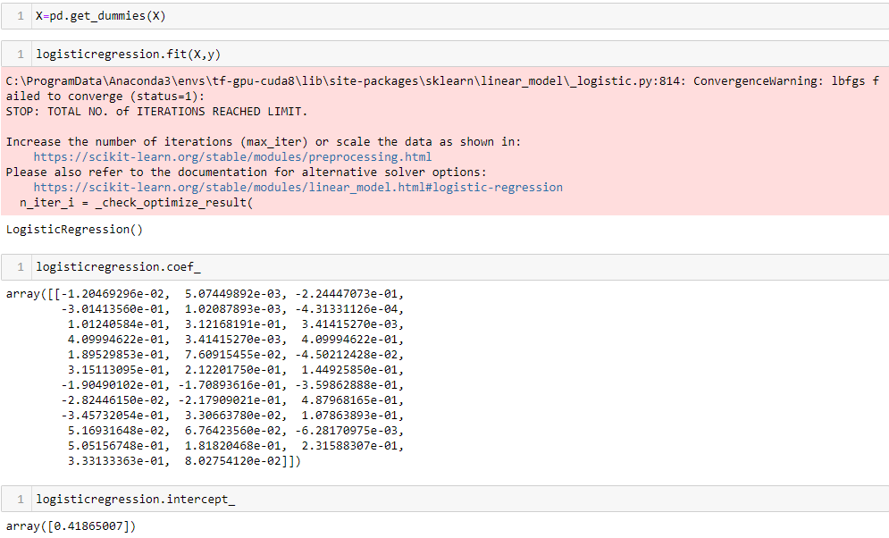
Output

Slide 6
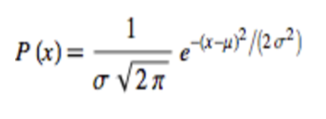
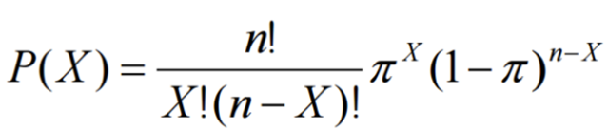
Normal and Binomial Distributions
Normal Distribution:
Normal distribution or Gaussian distribution is a very common continuous probability distribution. The normal distribution is sometimes informally called the bell curve.
The probability density of the normal distribution is:
Binomial Distribution:
Every random variable has a corresponding probability distribution. The probability distribution applies the theory of probability to describe the behavior of the random variable. A discrete random variable X has a finite number of possible integer values.
Using this formula, the probability distribution of a binomial random variable is calculated

Slide 7
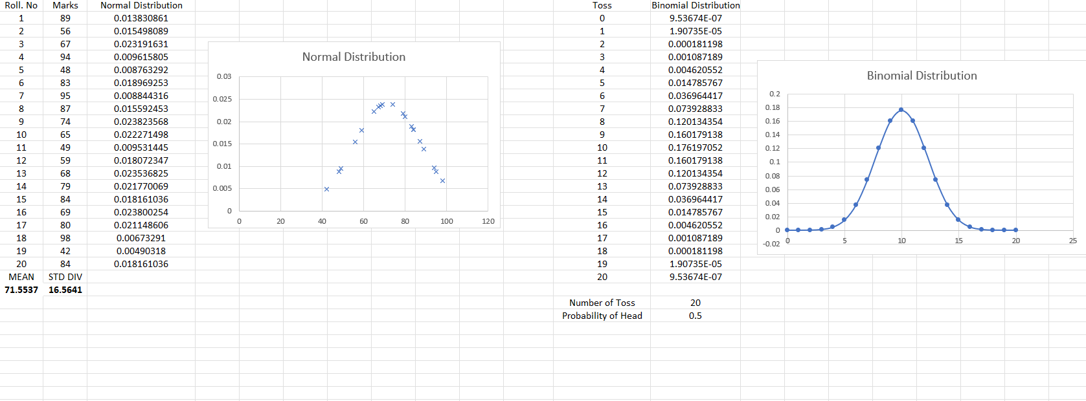
Normal Distribution

Slide 8
Binomial Distribution

Slide 9
Thank You

